Slide 1
Employee Attrition Analysis using Microsoft Power BI
Created by
Viswadhanush B R

Slide 2
Problem Statement
XYZ company which was established a few years back is facing around a 15% attrition rate for a couple of years. And it's majorly affecting the company in many aspects.
In order to understand why employees are leaving the company and reduce the attrition rate, XYZ company has approached an HR analytics consultancy for analyzing the data they have.
You are playing the HR analyst role in this project and building a dashboard which can help the organization in making data-driven decisions.

Slide 3
Project Overview
An Employee Attrition Analysis Dashboard built-in Microsoft Power BI!
This project offers comprehensive insights into employee attrition, enabling strategic decision-making and optimization of HR strategies.

Slide 4
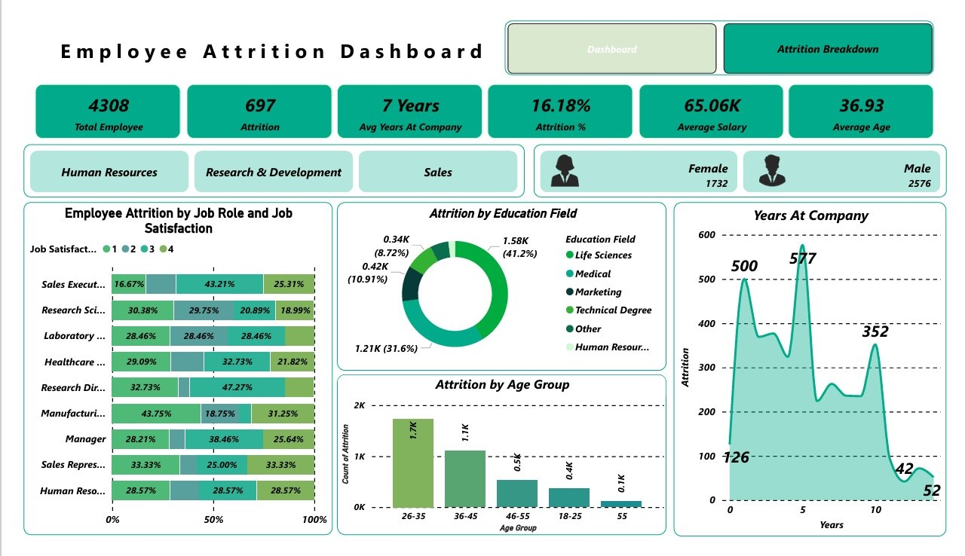

Slide 5
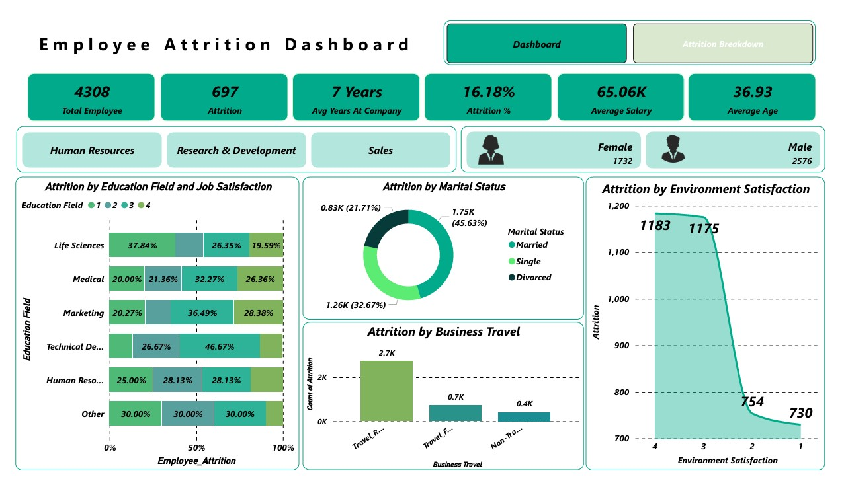

Slide 6
Output
Use Power BI
Employee Attrition Analysis Dashboard.pbix

Slide 7
Project Highlights
DAX (Data Analysis Expressions):
Utilized to create complex calculations and measures for deeper insights.
Data Modelling:
Designed effective data models to ensure efficient data handling.
Advanced Visualization Techniques:
Created interactive and visually appealing dashboards for better decision-making.
Data Transformation:
Transformed and cleansed data for accurate analysis.

Slide 8
Project Highlights
Parameters & What-If Analysis:
Implemented scenarios for strategic planning and forecasting.
Advanced Analytics:
Leveraged analytical tools for predictive insights.
Performance Optimization:
Fine-tuned performance for fast and efficient reporting.

Slide 9
Thank you

